Slide 1
Doing Data Science
Unit 3
Jacquie Cheun
Data Science @ SMU

Slide 2
Admin notes
Live Session Unit 02 assignment due today
Live Session Unit 03 assignment due next Tuesday

Slide 3
Main topics ref: http://datascienceatthecommandline.com/
File management concepts
Command line/shell commands
Cloud storage and version control systems: Dropbox & Git/Github

Slide 4
Three similar command line systems
Unix/Linux/Mac OS: /ExampleProject/Data
Windows: c:\ExampleProject\Data
R : c:\\ExampleProject\\Data

Slide 5
File paths & structure
Root C:\ (windows)
/ (unix/OS)
Subdirectory & Parent directories C:\Example\Data
/Example/Data
Working directory: the directory or folder the user is currently in

Slide 6
Absolute and relative paths
Absolute: the entire path starting from the root
/Example1/Data/file.txt
Relative: (assuming working directory is Example1)
Data/file.txt\
Unix/OS example: /Test1/Data vs Test1/Data
What are the advantages of relative paths over absolute paths?

Slide 7
Escape characters
Alternate interpretations for character sequences which may have a primary interpretation in the shell system.
These may be literal character interpretations or a specific function.
Examples: \$ \& \# \’
Newline: \n
Tab: \t

Slide 8
File manipulation commands
Get working directory
R: getwd() Unix: pwd
List working directory contents
R: list.files() Unix: ls
Set working directory
R: setwd(“Ex/Ds1”) Unix: cd Ex/Ds1
Delete files
R: unlink(“/file.txt”) Unix: rm file1.txt
Move files
R: file.rename(..) Unix: mv SRC DST
Copy files
R: file.copy(..) Unix: cp SRC DST

Slide 9
A few more notes..cd & echo
Change directory (unix):
To move one directory above: cd ..
To move to the previous working directory (if applicable): cd -
Echo → a print function
echo MSDS at SMU # MSDS at SMU
Can also be used to create files with input (replace > with >> for append)
echo MSDS at SMU > file.txt

Slide 10
cat
In R (concatenate & print): create content to file or append content to file
cat(“MSDS class”, file=”example.txt”, append=TRUE)
In unix: merge, display or copy files
cat file1.txt #output file1.txt on terminal
cat file1.txt file2.txt #combine file1 and 2 and output on terminal
cat file1.txt file2.txt > newcombinedfile.txt #combine 1 & 2 into a new file
cat file1.txt >> file2.txt #append file1 to file2
cat file1.txt file2.txt file3.txt | sort > test4 #??

Slide 11
Awk -A powerful data-driven text processing and extraction language in unix
Ref: shell basics http://mlwhiz.com/blog/2015/10/11/shell_basics_for_data_science_2/
Usage: awk ‘pattern {action}’ input-file > output-file
(or | command --”pipe”)
Reads as: take each line of the input file and if it matches the pattern (optional) apply the action to the line and write it to the output file
awk ‘{print $3}’ data.txt > output.txt
# take the 3rd column from data.txt and write it to output.txt

Slide 12
awk ‘$5 == ”\$5.50” {print $2}’ data.txt
# print the element at the 2nd column for every line where the 5th column = “$5.50”
What’s this awk command doing?
awk ‘{if ($1 > 30) {sum += $1;} END {print sum}’ data.txt

Slide 13
Cloud Storage and version control systems
Dropbox: file hosting service, cloud storage, file synchronization
Github:a version control and hosting service built on top of git, a distributed vcs.
How Github conquered Google, Microsoft and everyone else
https://www.wired.com/2015/03/github-conquered-google-microsoft-everyone-else/

Slide 14
Git - a simple intro
Let’s add a new project to github:
git init #initialize a local directory as a git repo
git clone <github repo URL> #or, clone a remote repo
.gitignore file:
files that git should not track such as intermediate byproduct files
E.g, *.exe, *.dll, *.project, *.RHistory, *.RData, *.knit.md
Some common .gitignore configurations https://gist.github.com/octocat/9257657

Slide 15
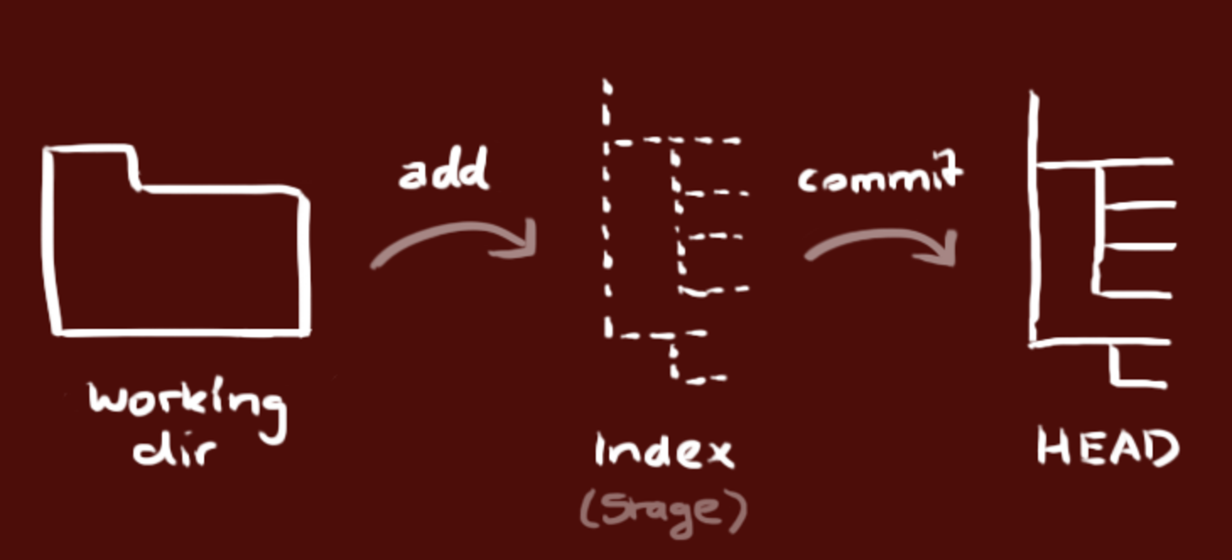
Git workflow
Working directory: holds the actual files
Index: staging area
Head: points to the last commit

Slide 16
git add RData.rmd #add a file to Index, or
git add * #add all files in current working folder to Index
git commit -m “Added first set of files” #file(s) now committed to HEAD
git push origin master #send changes to the repo
If you haven’t cloned an existing repo, you need to connect your server to a remote repo (after creating it on Github):
git remote add origin <serverURL>

Slide 17
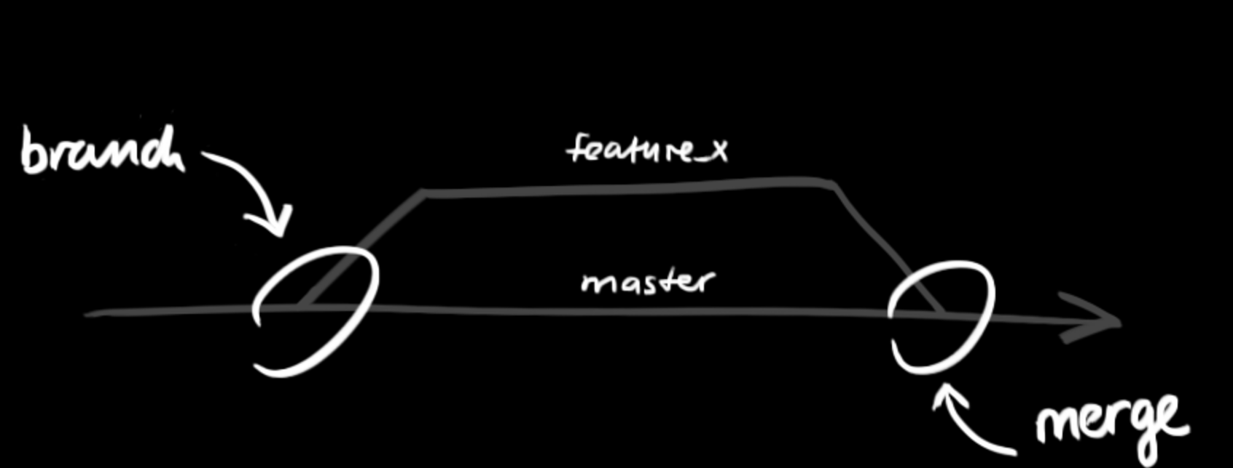
Branching in git

Slide 18
git checkout -b TestBranch #create a new branch
git checkout master #switch to master branch
git push origin TestBranch #push to remote repo
git branch -d TestBranch #delete TestBranch

Slide 19
Update & Merge
git pull
#update local repo to latest remote commit
git merge <branch>
#merge another branch into your current branch
git diff <source_branch> <target_branch>
#get a preview of potential merge conflicts and/or file changes

Slide 20
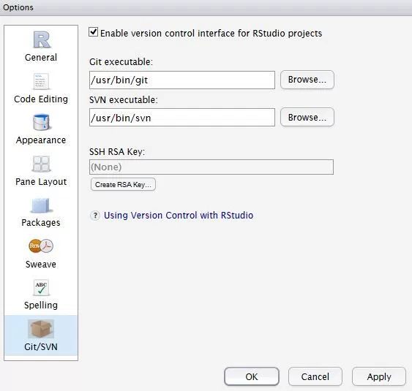
RStudio and Github
Ensure that Git is installed
Tools→ Global Options, ensure path to git exe is correct (esp for Windows)
RSA key and account info should already be preconfigured if Github installed before RStudio.
Else, generate RSA key, associated with Github account, and configure user account info via Tools → Shell

Slide 21
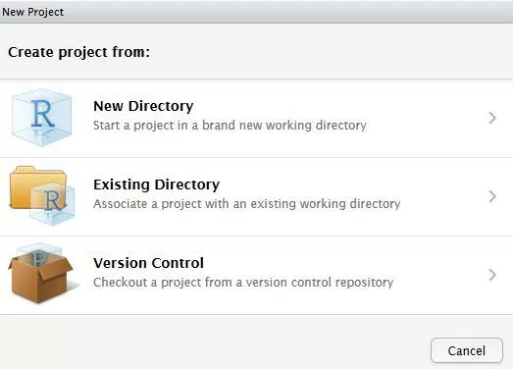
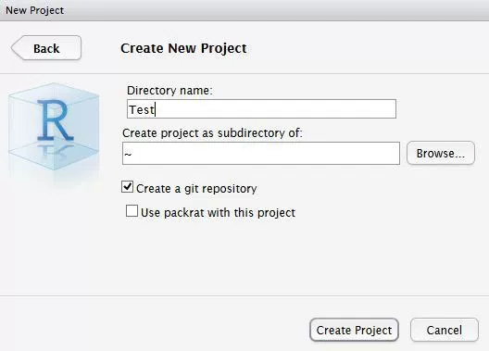
Create new Git Repo

Slide 22
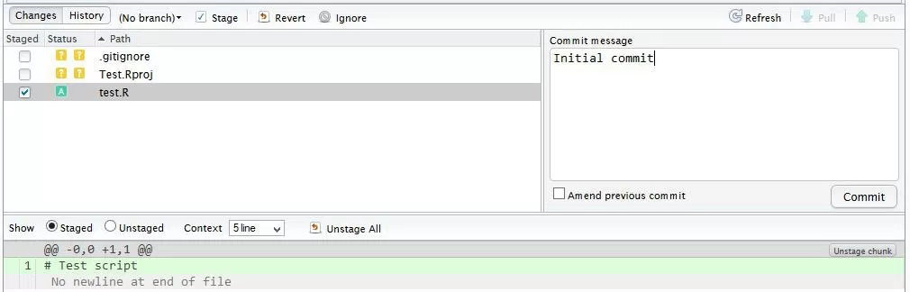
Add & Commit a file in RStudio

Slide 23
Push a file to remote in RStudio
Ensure repo exists on Github
In Tools → Shell, you might need to configure the remote origin:
git remote add origin https://github.com/faizanj/test.git git config remote.origin.url git@github.com:faizanj/test.git git pull -u origin master git push -u origin master
After this initial configuration the Push and Pull buttons in RStudio will work
(-u: set upstream tracking for git pull)

Slide 24
Workflow of Reproducible research
Data Gathering
Data Analysis
Results Presentation

Slide 25
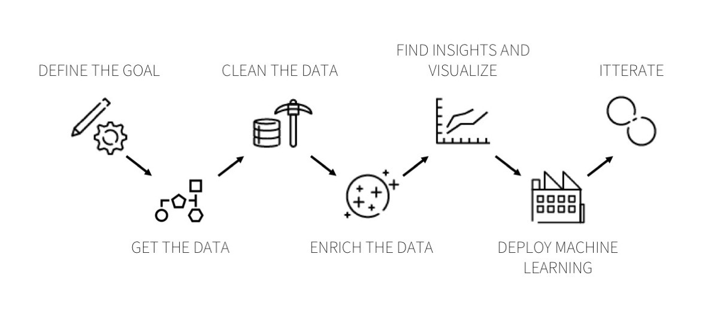
The Data Science Process
Codebook: documenting all the steps and details of a specific data science process (mainly used for data analysis - focus on variables).

Slide 26
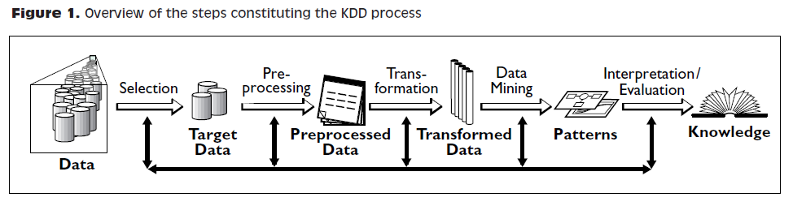
The Data Science Process

Slide 27
Data Munging/Cleaning - Data Janitorial tasks
Numeric/Text transformations:
Normalization, tokenization, remove stop words, filter inconsistent values, impute missing values, numeric values binning
Data transformations:
Convert date formats, enrich with geo data, convert currency, deduplication
Open Source tool: Google Refine http://openrefine.org/

Slide 28
Dirty data examples
Naming conventions: TX vs Texas
Parsing text into fields (separator issues)
Missing required field
Different representations (5 vs Five)
Redundant records (exact match etc)
Formatting issues with dates and other metrics
Outliers (e.g., 200 in age column)

Slide 29
Exploratory Data Analysis (EDA)
Understanding and exploring clean/tidy data
Plotting distributions of all variables
Time series of data
Transforming variables, pairwise relationships between variables
Generating summary statistics of data
(mean, minimum, maximum, upper and lower quartiles, outliers)

Slide 30
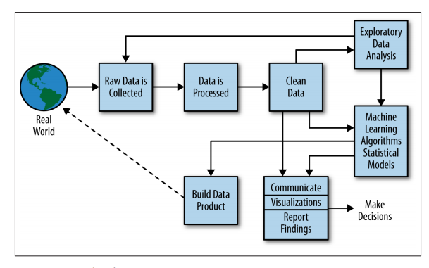
Putting it all together

Slide 31
Makefiles
A program building tool that compiles and links a program which might be composed of several source code files and dependencies.
In our context: applied to the data gathering process
“Segment data gathering into modular files and tie them together”
Gather data → Clean → Merge
Two flavors: R Make-like files and GNU Make files

Slide 32
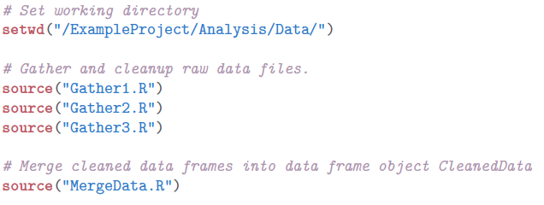
R Make-like files
R files which locate and execute data gathering steps.
Usually only use setwd and source commands.
Runs source files without any regard to the timestamp of the output (might be less efficient for multiple steps and computationally intensive steps).

Slide 33
GNU Make files https://www.gnu.org/software/make/manual/make.html
Run makefiles from RStudio’s Build tab or the shell.
Unlike R make-like files, will only run a source file if its timestamp is older than its outputs’ timestamp...and tabs are important!
Input files are called prerequisites (run in alphanumeric order)
Output files are called targets
The steps to create targets from prerequisite are called recipe
Syntax:
TARGET … : PREREQUISITE …
RECIPE
…
...

Slide 34
# Key variables to define
RDIR = .
MERGE_OUT = MergeData.Rout
# Create list of R Source files; Wildcard syntax: $(wildcard PATTERN)
RSOURCE = $(wildcard $(RDIR)/*.R)
#Files to indicate when the RSOURCE file was run
OUT_FILES = $(RSOURCE: .R=.Rout)
#default target
all : $(OUT_FILES)

Slide 35
#Run the RSOURCE files- Rout files are the target, % sign replaces name of files
#call R from shell, $< indicates first pre-req for target, i.e., the .R files
$(RDIR)/%.Rout: $(RDIR)/%.R
R CMD BATCH $<
# Remove .Rout files - runs when you type make clean
clean:
rm -fv $(OUT_FILES)
# Remove MergeData.Rout
cleanMerge:
rm -fv $(MERGE_OUT)

Slide 36
What did you learn today?
Questions?

